Slide 1
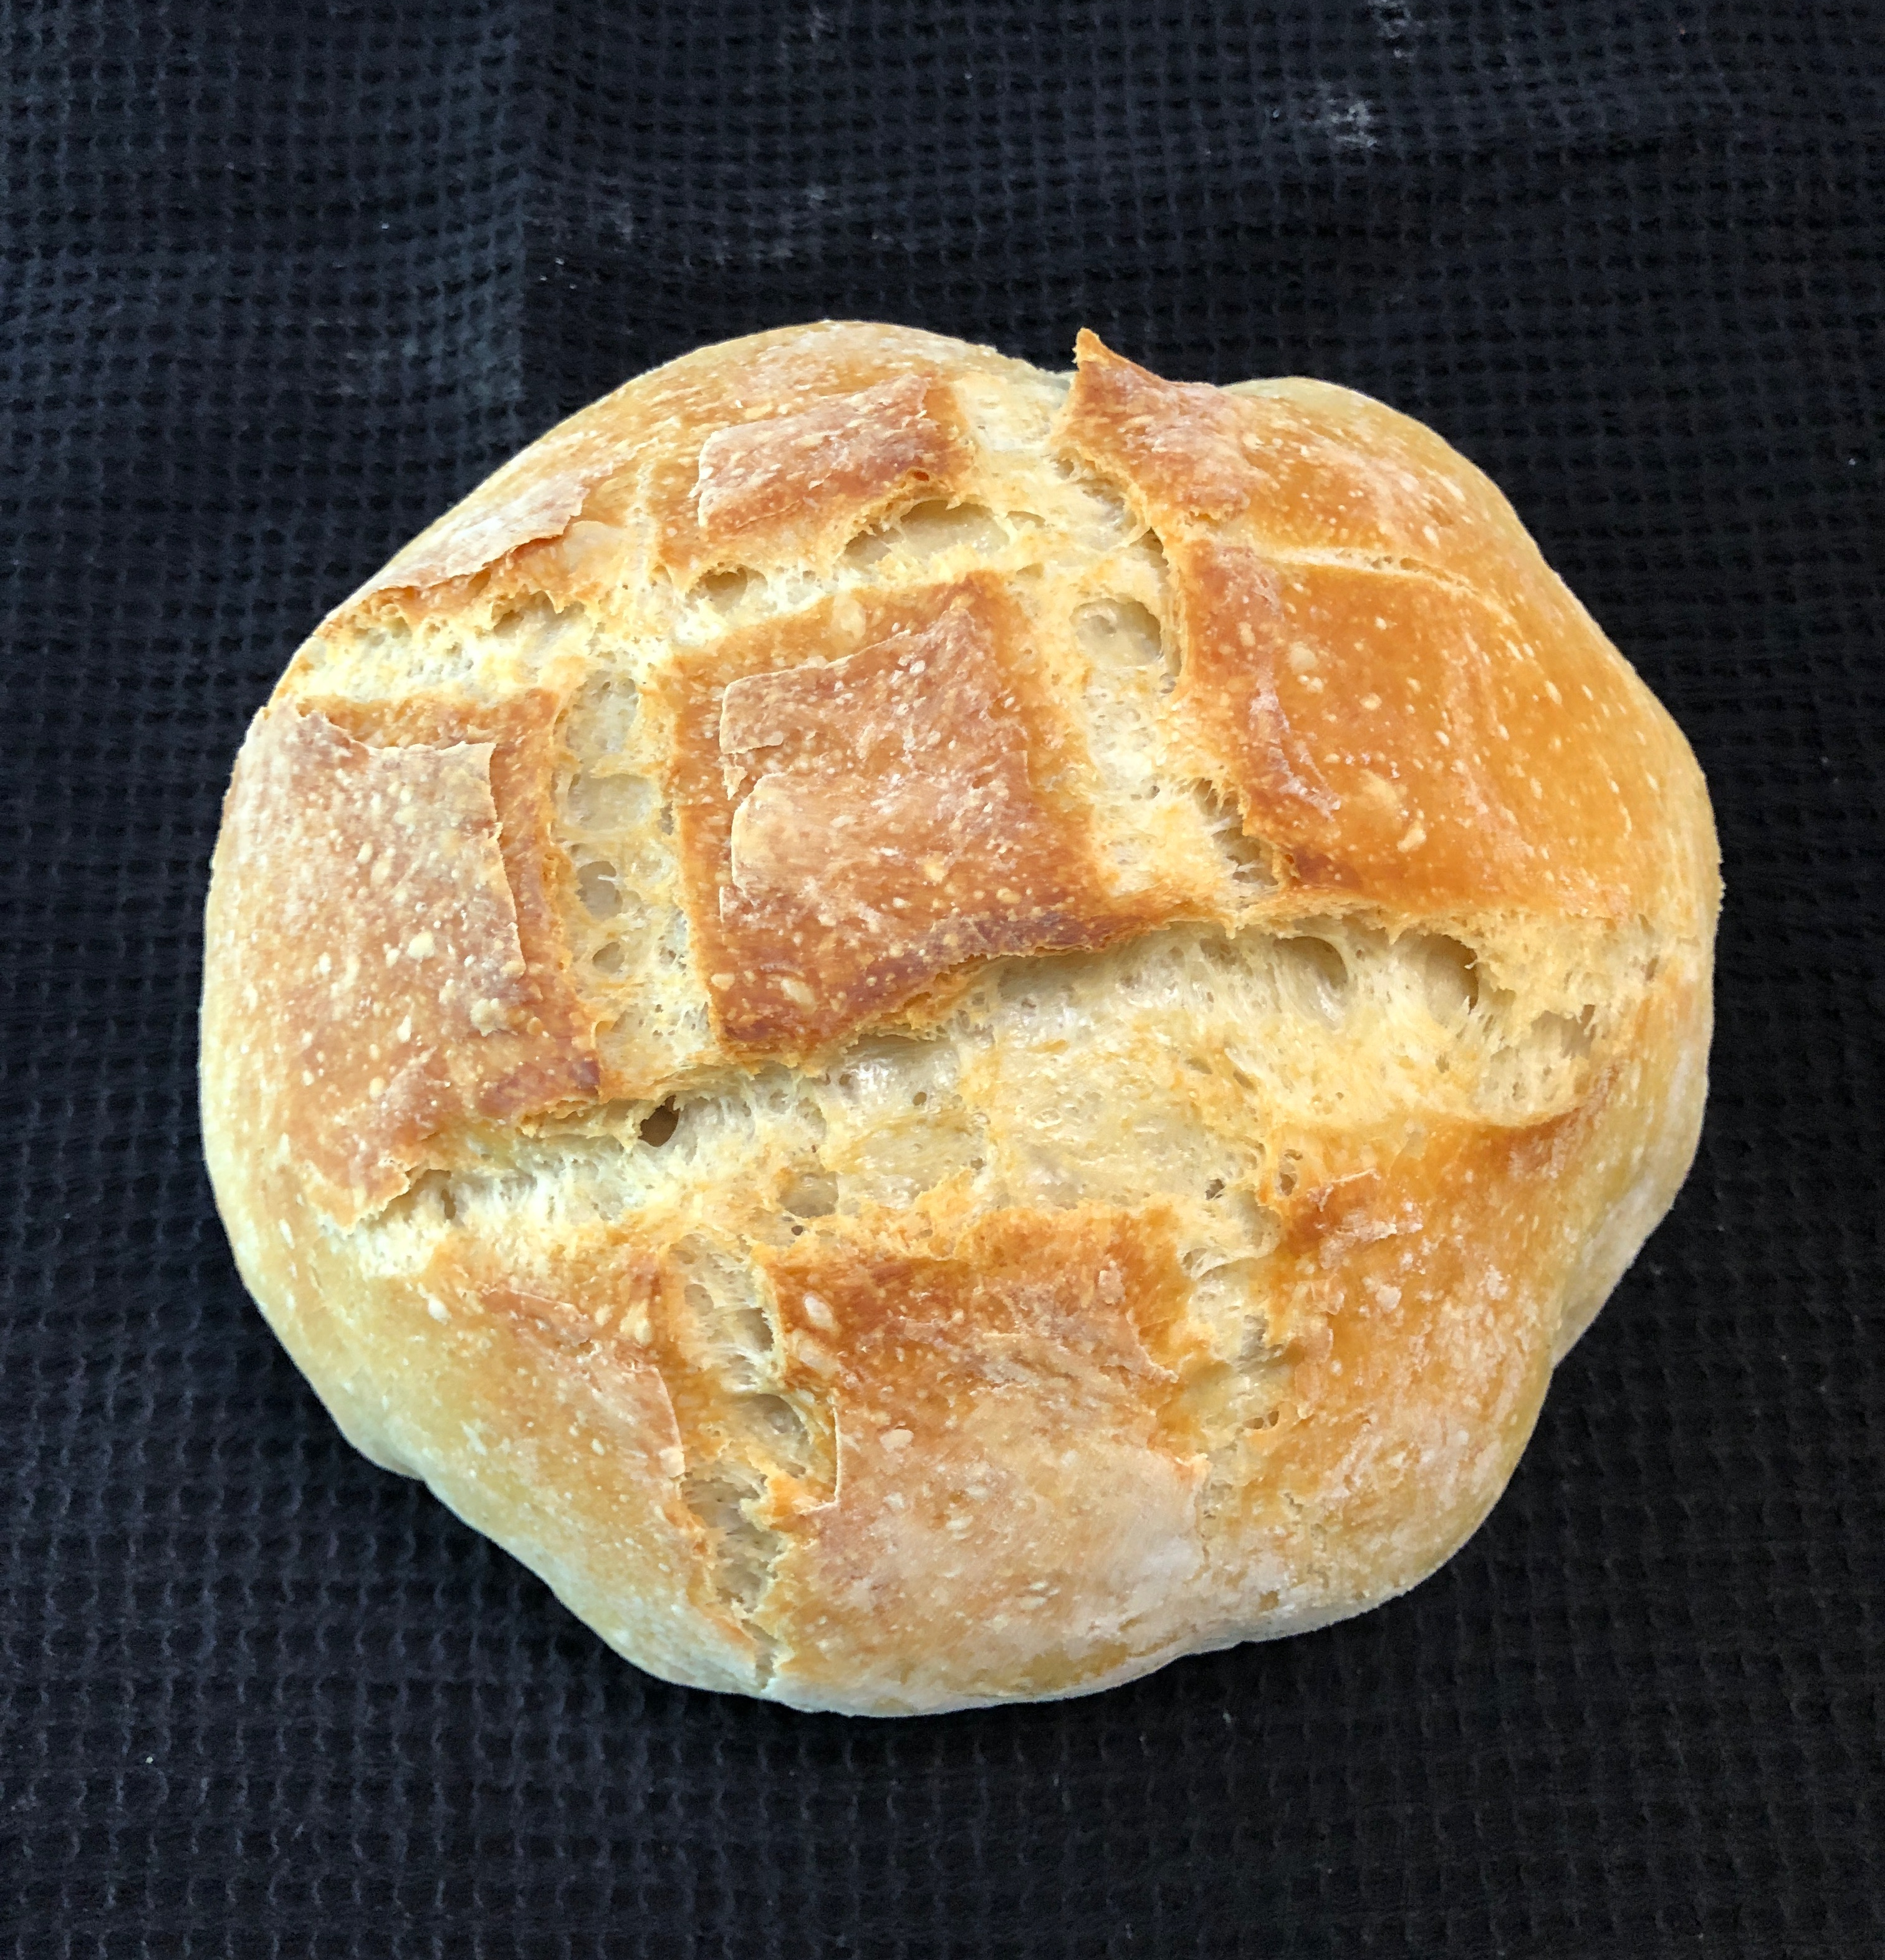
Is There a Perfect Recipe for a Happy Family?
What learning to bake a perfect loaf of bread taught me about the importance of having the Holy Spirit in our lives.

Slide 2
I recently found a recipe for artisan bread with just four ingredients: flour, water, salt and just a tiny bit of yeast. The secret to the bread is time, and the Dutch Oven you bake it in. The bread rises for 18-24 hours and you end up with that crusty outside and chewy inside that we love in restaurant bread.
What does this have to do with creating a happy family? The yeast is the life in the bread. How can we bring the living leaven of Christ’s love into our family interactions. That love, that life, is the key to a family that stays together through all of the challenges of life.

Slide 3
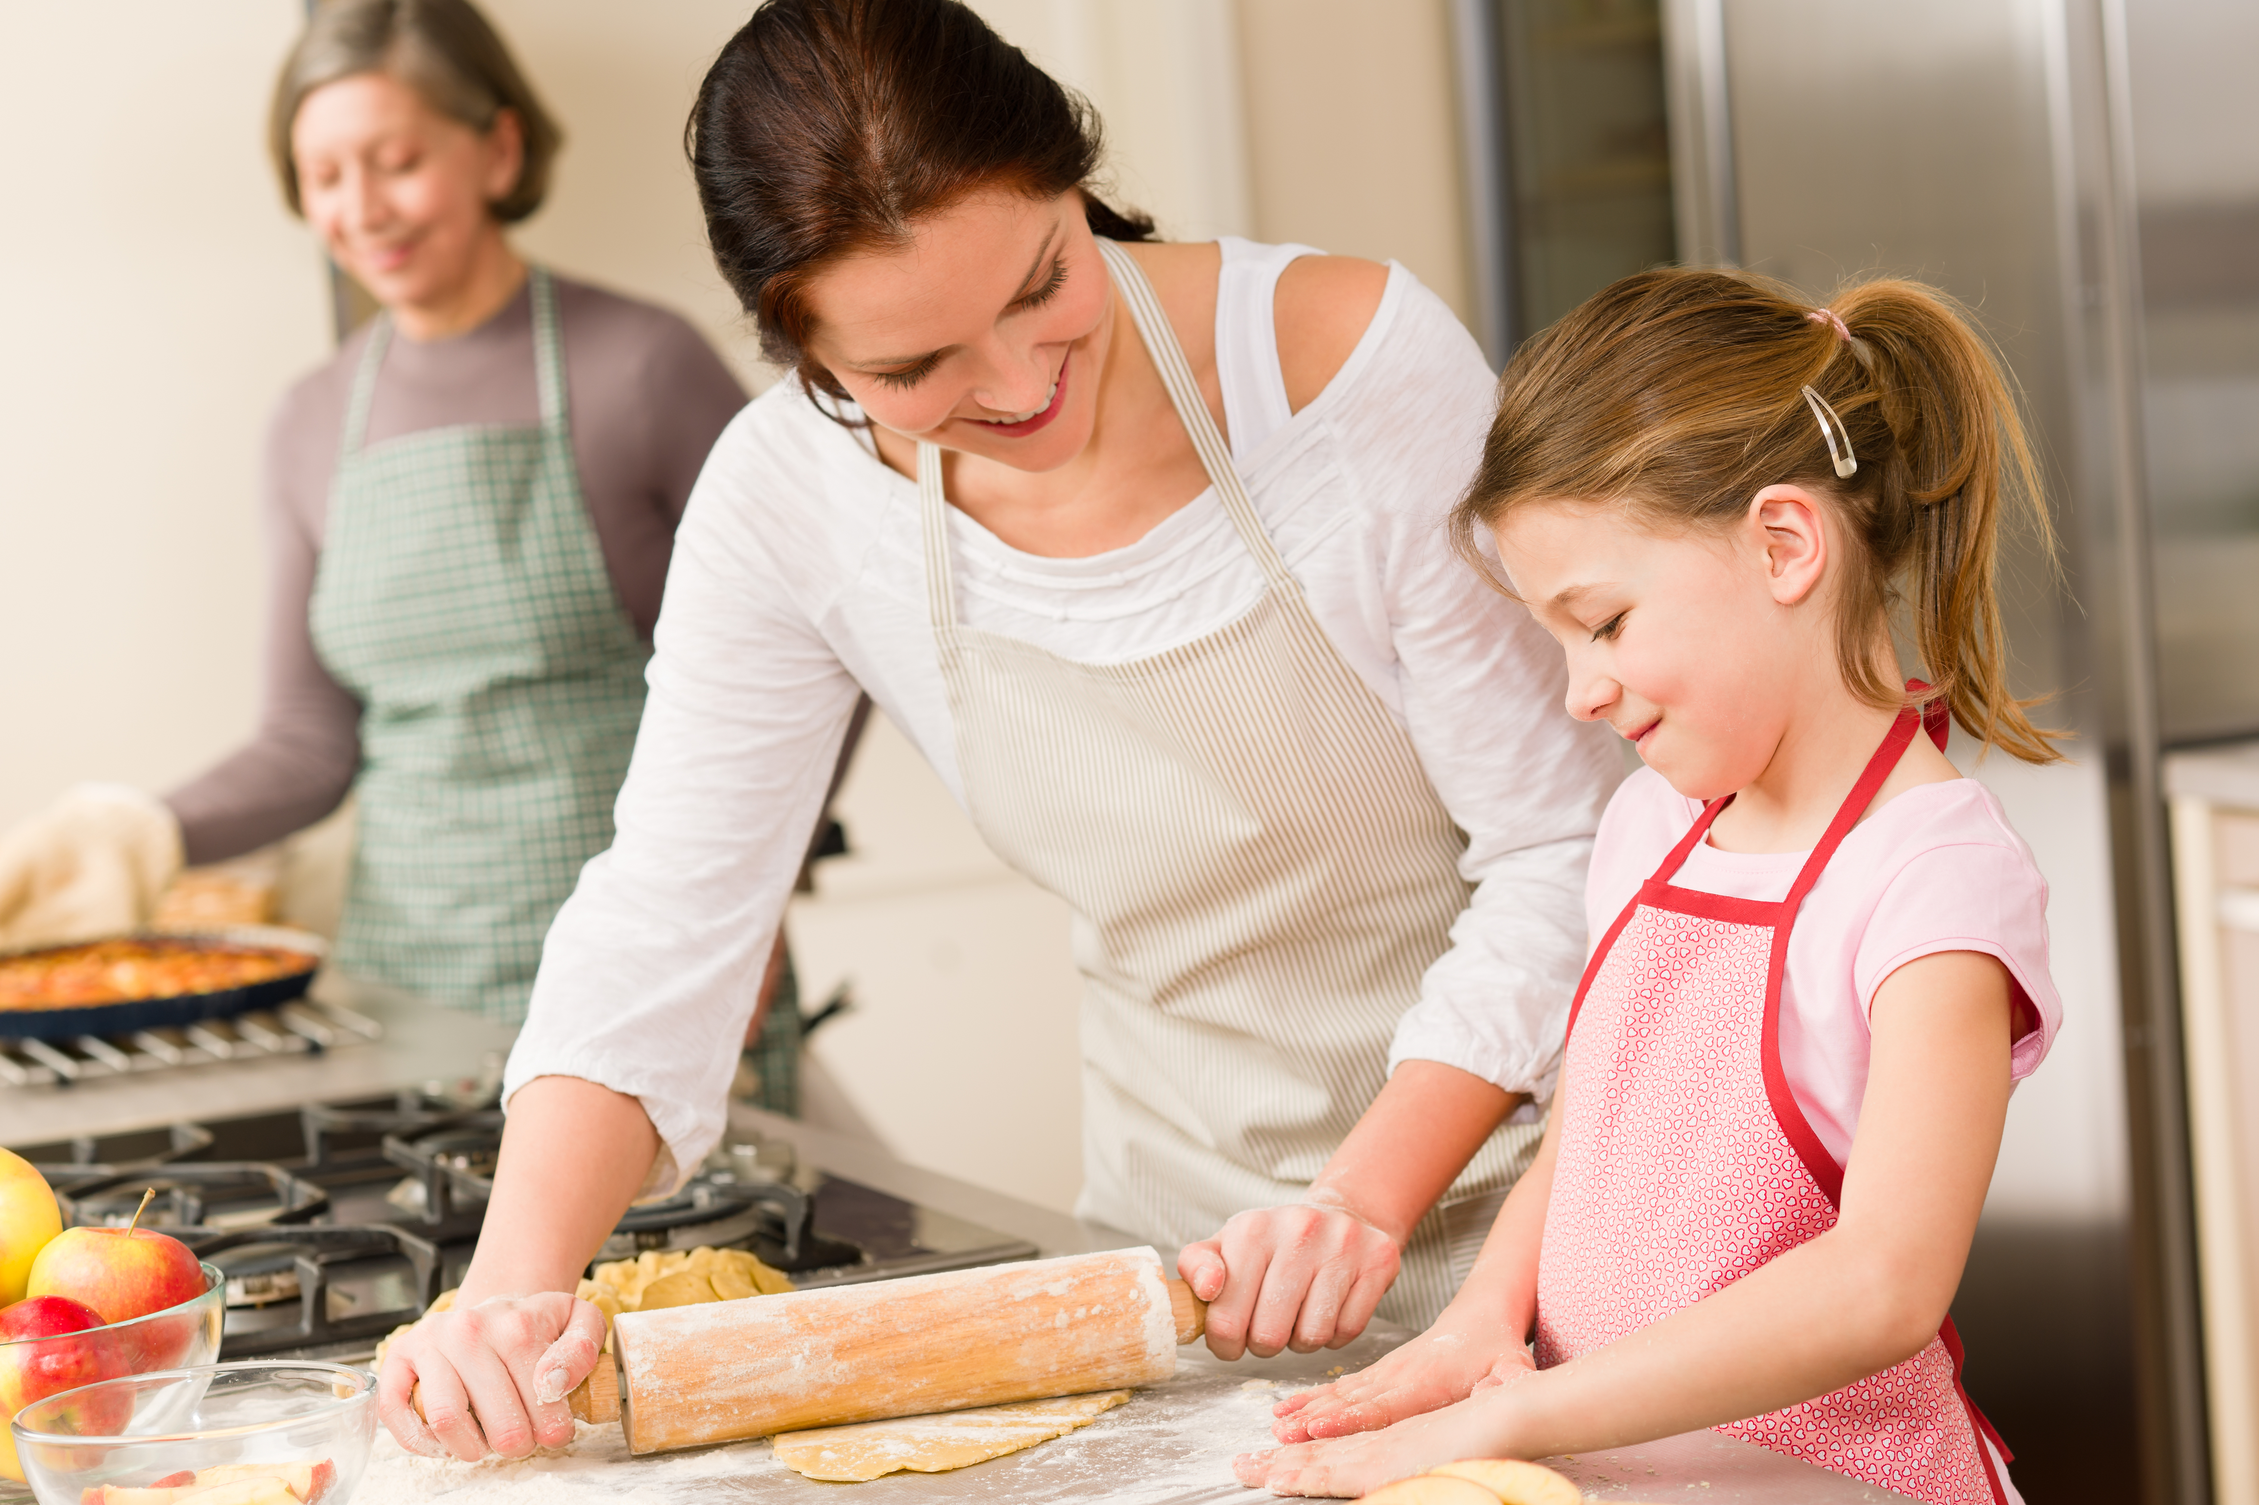
We Want Our Families to Look Like this

Slide 4
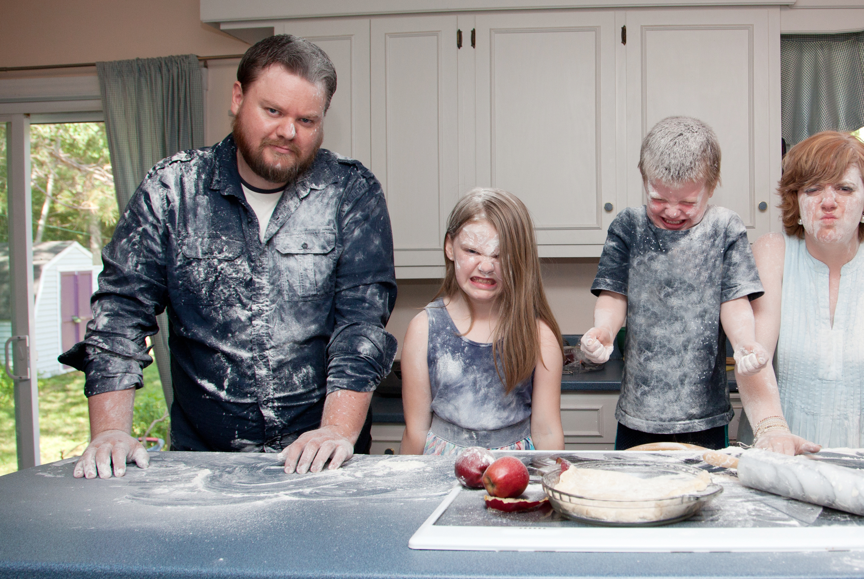
But sometimes they look more like this

Slide 5
“In coming days it will not be possible to survive spiritually without the guiding, directing, comforting and constant influence of the Holy Ghost.”
Pres Russell M Nelson
How do we get it right?

Slide 7
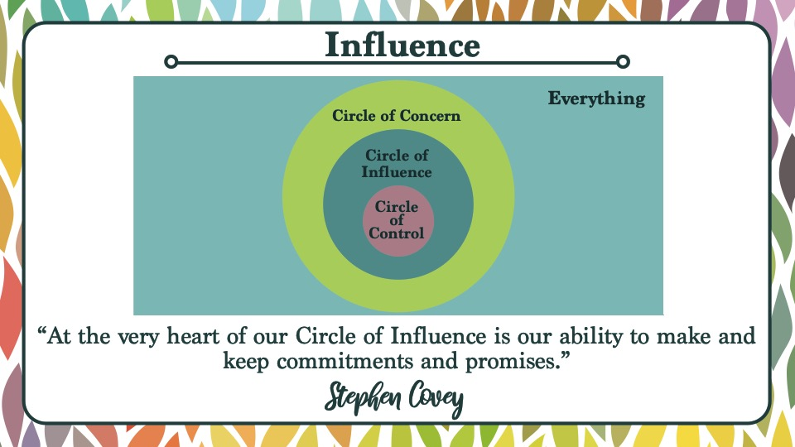

Slide 10
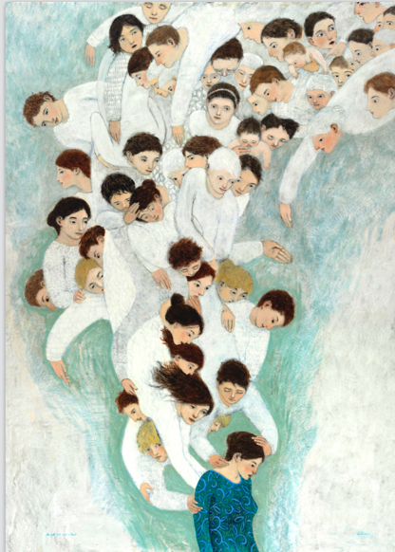
“Ask for Angels to Help You.”
Could you use a little more help in your life? If so, And then ask for angels (a.k.a. your ancestors and other loved ones) to help you with whatever you need. Or ask for them to be dispatched to help those you love!
Wendy Watson Nelson

Slide 11
The Perfect Recipe for a Happy Family
Try to Keep Your Covenants
01
Influence Rather than Control
02
Ask for Angels to Help You
03
Trust in Jesus +
04
Time and Patience
05

